Slide 1

LLM Engineering
MASTER AI & LARGE LANGUAGE MODELS

Slide 2
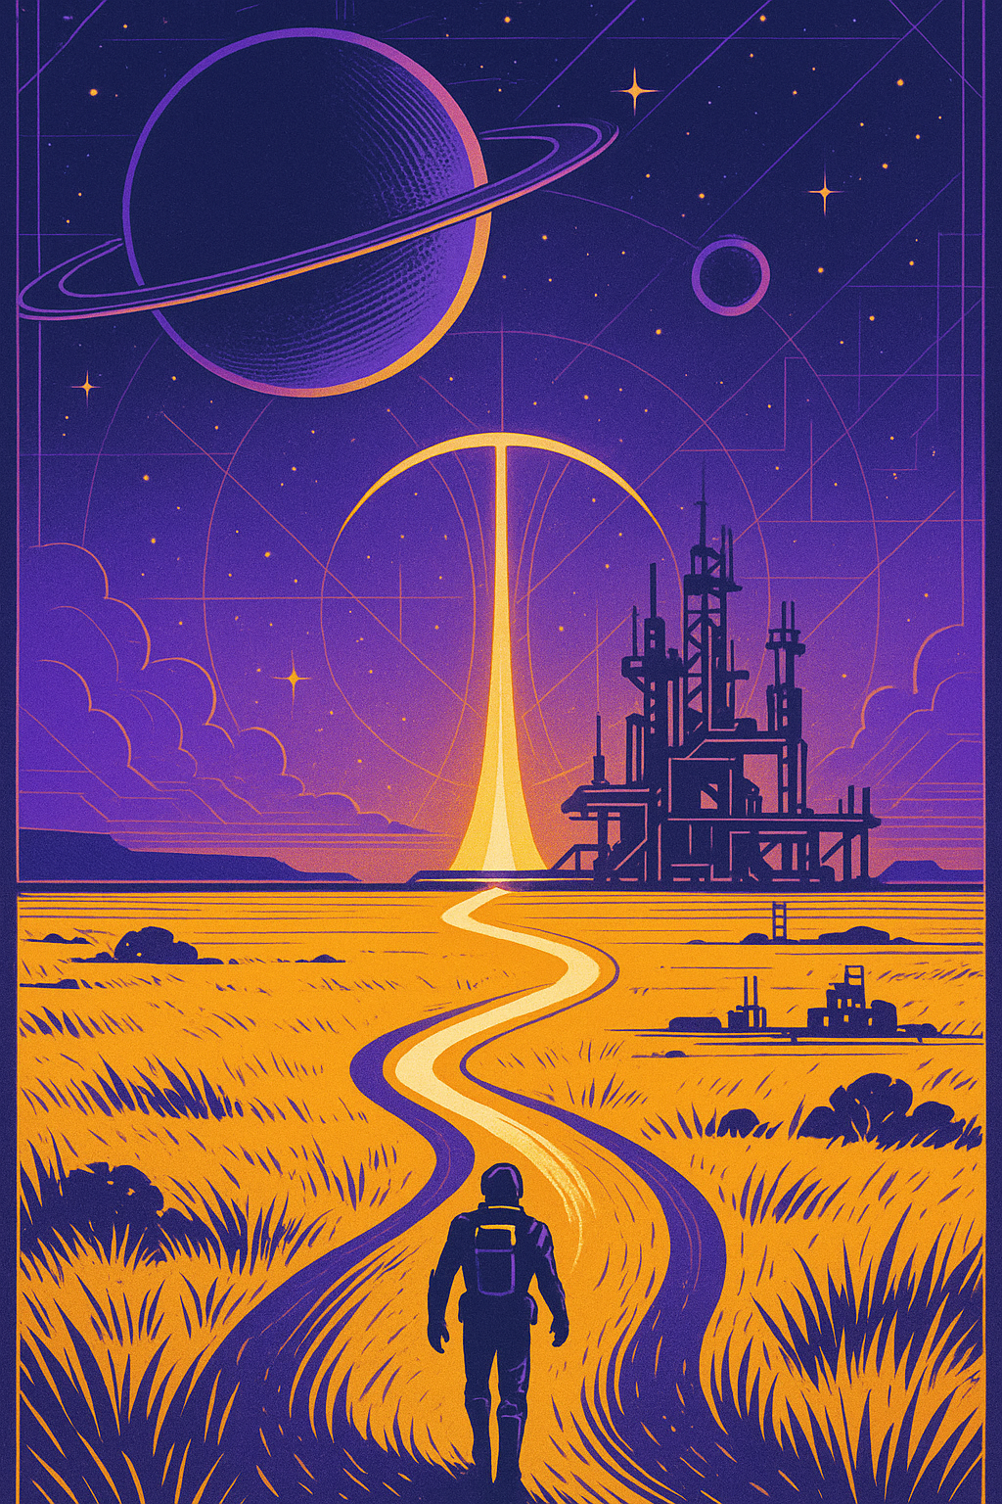
PROGRESS
Massive week ahead
What you can now do
Generate text and code with Frontier Models including AI Assistants with Tools, and with open-source models with Hugging Face transformers
Create advanced RAG solutions with LangChain
Follow a 5 step strategy to solve problems, including dataset curation and making a baseline model with traditional ML, DL and making a Frontier solution, and fine-tuning Frontier Models
Today your advanced journey begins - you will soon be able to:
Explain LoRA for fine-tuning Open Source models
Describe Quantization and QLoRA
Explain 3 key hyper-parameters: r, alpha and target modules

Slide 3


RECAP: YOUR 8 WEEK JOURNEY TO MASTERY
Week 3
Week 8
Week 3 - Open Source with Hugging Face
The Finale - Agentic AI
Week 4
LLM ENGINEER
Selecting LLMs and Code Generation
Week 2
Frontier Models with APIs, UIs and Multi-modality
Week 7
Week 1
Week 6
Fine-tuning an Open-Source Model
Foundations and the
Chat Completions API
Week 5
Fine-tuning a Frontier Model
RAG and Question Answering - Creating an Expert
YOU WERE HERE

Slide 4
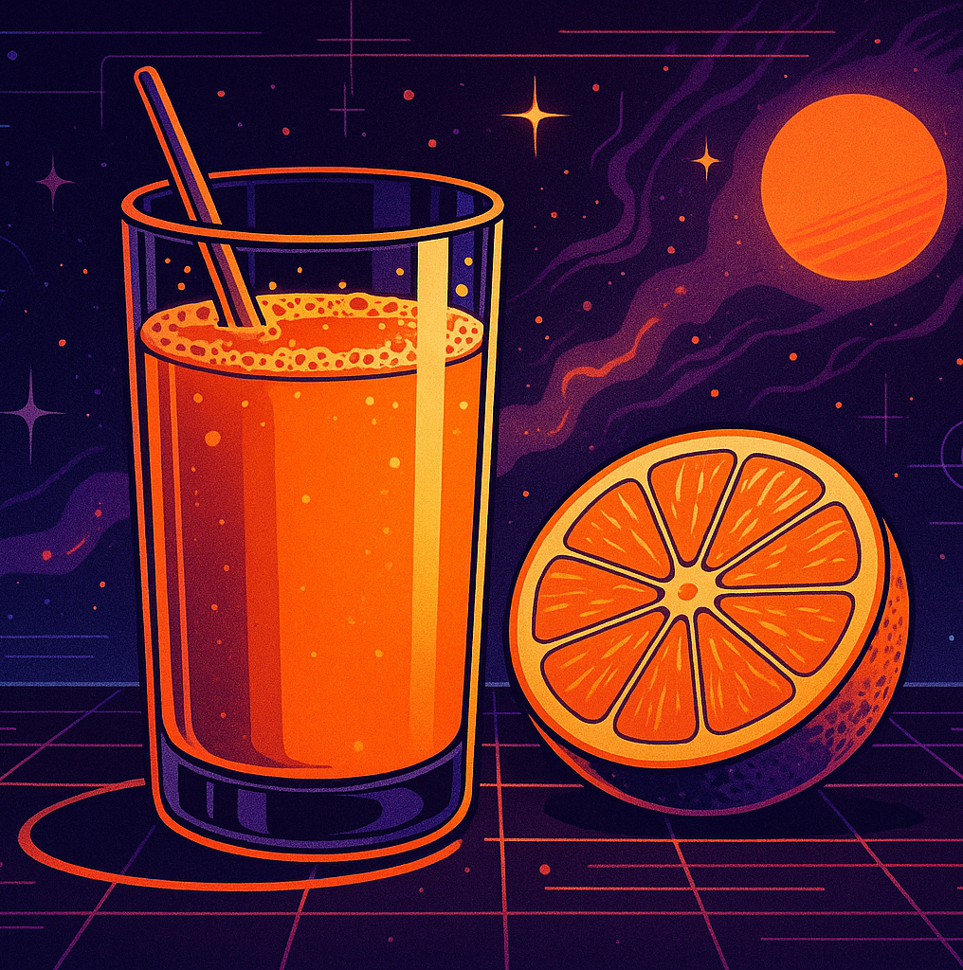
BUT FIRST, TO INTRODUCE THE CAPSTONE PROJECT
A juicy commercial problem: The Price Is Right
Given a description of a product, predict its price
The true value of a product
This will ultimately be incorporated in an Agentic Solution that will hunt for bargains
Frontier models have done amazingly. Can we fine-tune an open-source model to have comparable performance at a fraction of the size?

Slide 5
The Price Is Right
THE ORDER OF PLAY:
Week 6: Data Curation, Evaluation, Frontier Models
Week 7: Fine-tune Open-Source LLM
Day 1: Introducing QLoRA Day 2: Prompt dataset & base model eval Day 3: Training Part 1 Day 4: Training Part 2 Day 5: Evaluation
Week 8: Deployed model, RAG, Agentic Product

Slide 6
High level explanation of LoRA
Using Llama 3.2 with 3B weights - far too much for us to train on a GPU
Llama 3.2 3B architecture consists of 28 groups of modules stacked on top of each other, called 'Llama Decoder Layers'
Each has self-attention layers, multi-layer perceptron layers, SiLU activation and layer norm
These parameters take up 13GB memory

Slide 7
High level explanation of LoRA
Step 1: Freeze the weights - we will not optimize them

Slide 8
High level explanation of LoRA
Step 2: Select some layers to target, called "Target Modules"
Target Module
Target Module
Target Module

Slide 9
High level explanation of LoRA
Step 3: Create new "adaptor" matrices with lower dimensions, fewer parameters
Target Module
Low Rank Adaptor
Target Module
Low Rank Adaptor
Low Rank Adaptor
Low Rank Adaptor
Target Module
Low Rank Adaptor

Slide 10


High level explanation of LoRA
Step 4: Apply these adaptors to the Target Modules to adjust them - and these get trained
Target Module
Low Rank Adaptor
Target Module
Low Rank Adaptor
Low Rank Adaptor
Low Rank Adaptor
Target Module
Low Rank Adaptor

Slide 11
High level explanation of LoRA
To be more precise: there are in fact two LoRA matrices that get applied
LoRA_a
Target Module
LoRA_a
LoRA_b
Target Module
LoRA_a
Low Rank Adaptor
Low Rank Adaptor
LoRA_b
LoRA_a
LoRA_b
Target Module
Low Rank Adaptor
Low Rank Adaptor

Slide 12



Three Essential Hyperparameters
For LoRA Fine-Tuning
r
Alpha
Target Modules
The rank, or how many dimensions in the low-rank matrices
A scaling factor that multiplies the lower rank matrices
Which layers of the neural network are adapted
RULE OF THUMB:
RULE OF THUMB:
RULE OF THUMB:
Start with 8, then double to 16, then 32, until diminishing returns
Twice the value of r
Start by targeting the attention heads

Slide 13

Quantization - the Q in QLoRA
Even the 3B variants are enormous
3 Billion * 32 bits = 13GB
Intuition: keep the number of weights but reduce their precision
Model performance is worse, but the impact is surprisingly small
Reduce to 8 bits, or even to 4 bits
Technical note 1: 4 bits are interpreted as float, not int
Technical note 2: the adaptor matrices are still 32 bit

Slide 14
Size of Weights in MB
13,000
2,200
3,600
73
Llama 3.2 3B
Quantized to 8 bit
Quantized to 4 bit
QLoRA with r=32
The LoRA weights are 32 bit
But there are far fewer!

Slide 15
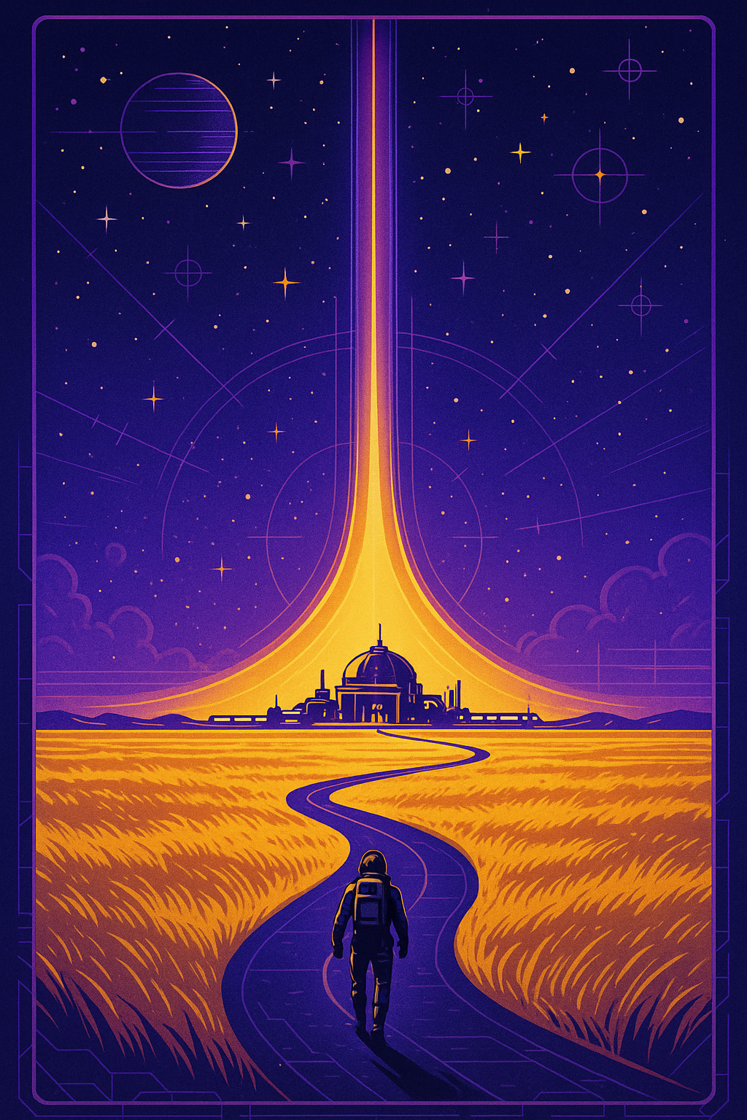
PROGRESS
Essential expertise acquired
What you can now do
Generate text and code with Frontier Models and Open Source models using APIs and Hugging Face, including tools, assistants and RAG
Follow a 5 step strategy to solve problems, including dataset curation, making a baseline model, and fine-tuning a Frontier model
Explain QLoRA for fine-tuning open-source models including defining target modules, r and alpha
By next time you will be able to:
Prepare data for fine tuning
Compare instruct and base variants for a task
Evaluate a base model against a business objective

